Slide 1
Four Practice Problems on Linear Regression
(Taken From Interviews For Data Scientist Role)

Slide 2
Previous Videos
Linear Regression Theory (2022-02-15)
https://www.youtube.com/watch?v=qS3HhMV8YG0
Interview Question 1: What is linear regression and what is it's primary purpose?
https://www.youtube.com/watch?v=9S2FM9EGcdc
Use Khan Academy to get started with the basic concepts of linear regression (Motivational video)
https://www.youtube.com/watch?v=glXMN1VIttA
Unit 5: Exploring bivariate numerical data
https://www.khanacademy.org/math/statistics-probability/describing-relationships-quantitative-data

Slide 3
Question (1): Asked At Ericsson
You are given the data generated for the following equation:
y = (x^9)*3
Can you apply linear regression to learn from this data?

Slide 4
Solution (1)
Equation of line: y = mx + c
Equation we are given is of the form y = (x^m)c
Taking log on both the sides:
log(y) = log((x^m)c)
Applying multiplication rule of logarithms:
log(y) = log(x^m) + log(c)
Applying power rule of logarithms:
log(y) = m.log(x) + log(c)
Y = log(y)
X = log(x)
C = log(c)
Y = mX + C
So answer is 'yes'.

Slide 5
Question (2): Infosys – Digital Solution Specialist
If you do linear regression in 3D, what do you get?

Slide 6
Solution (2)
When you perform linear regression on 3D data, you are essentially fitting a plane to a set of data points in three-dimensional space. The general form of the equation for a plane in three dimensions is:
z=ax+by+c
Here:
z is the dependent variable you are trying to predict.
x and y are the independent variables.
a and b are the coefficients that determine the orientation of the plane.
c is the intercept.

Slide 7
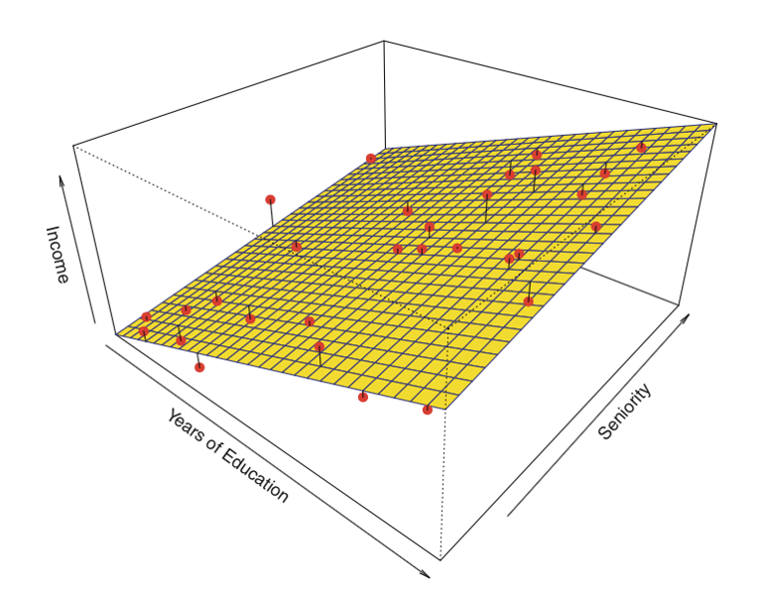
Solution (2)...
Suppose you have data points (1,2,3), (2,3,5), (3,4,7), and you fit a linear regression model to this data. The resulting plane might have an equation like z=0.8x+1.2y+0.5. This equation tells you how z changes as x and y change.
In summary, performing linear regression on 3D data gives you a plane in three-dimensional space that best fits your data points in the least squares sense. This plane can then be used to predict new z values given new x and y values.

Slide 8
Generalizing a bit further
If you do linear regression in N dimensions, you get a hypersurface in N-1 dimensions.

Slide 9
Question (3): Infosys – Digital Solution Specialist
How do you tell if there is linearity between two variables?

Slide 10
Solution (3)
Determining if there is linearity between two variables involves several steps, including visual inspection, statistical tests, and fitting a linear model to evaluate the relationship. Here are the main methods you can use:
1. Scatter Plot
Create a scatter plot of the two variables. This is the most straightforward way to visually inspect the relationship.
Linearity: If the points roughly form a straight line (either increasing or decreasing), there is likely a linear relationship.
Non-linearity: If the points form a curve, cluster in a non-linear pattern, or are randomly scattered without any apparent trend, there is likely no linear relationship.
2. Correlation Coefficient
Calculate the Pearson correlation coefficient, which measures the strength and direction of the linear relationship between two variables.
Pearson Correlation Coefficient (r): Ranges from -1 to 1.
r≈1 or r≈−1: Strong linear relationship (positive or negative).
r≈0: Weak or no linear relationship.
3. Fitting a Linear Model
Fit a simple linear regression model to the data.
Model Equation: y = β0 + β1.x + ϵ
y: Dependent variable. / x: Independent variable. / β0: Intercept. / β1​: Slope. / ϵ: Error term.

Slide 11
4. Residual Analysis
Examine the residuals (differences between observed and predicted values) from the fitted linear model.
Residual Plot: Plot residuals against the independent variable or the predicted values.
Linearity: Residuals are randomly scattered around zero.
Non-linearity: Residuals show a systematic pattern (e.g., curve, trend).
5. Statistical Tests
Perform statistical tests to evaluate the significance of the linear relationship.
t-test for Slope: Test if the slope (β1​) is significantly different from zero.
Null Hypothesis (H0): β1=0 (no linear relationship).
Alternative Hypothesis (H1): β1≠0 (linear relationship exists).
p-value: If the p-value is less than the chosen significance level (e.g., 0.05), reject H0​ and conclude that a significant linear relationship exists.
6. Coefficient of Determination (R²)
Calculate the R² value, which indicates the proportion of variance in the dependent variable explained by the independent variable.
R² Value: Ranges from 0 to 1.
Closer to 1: Indicates a strong linear relationship.
Closer to 0: Indicates a weak or no linear relationship.

Slide 12
Example:
Suppose you have two variables, x and y.
Scatter Plot: You plot x vs. y and observe a straight-line pattern.
Correlation Coefficient: You calculate the Pearson correlation coefficient and find r=0.85, indicating a strong positive linear relationship.
Fitting a Linear Model: You fit a linear regression model y=2+3x.
Residual Analysis: You plot the residuals and observe they are randomly scattered around zero, indicating no pattern.
Statistical Tests: The t-test for the slope gives a p-value of 0.001, indicating the slope is significantly different from zero.
R² Value: You calculate R^2=0.72, meaning 72% of the variance in y is explained by x.
Based on these steps, you would conclude there is a strong linear relationship between x and y.

Slide 13
Question (4): TCS and Infosys (DSS)
What is the difference between Lasso regression and Ridge regression?

Slide 14
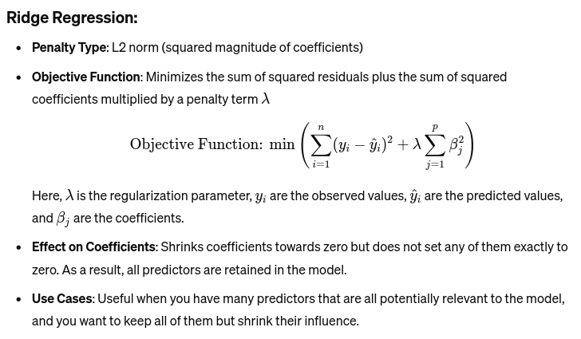
Solution (4)

Slide 15
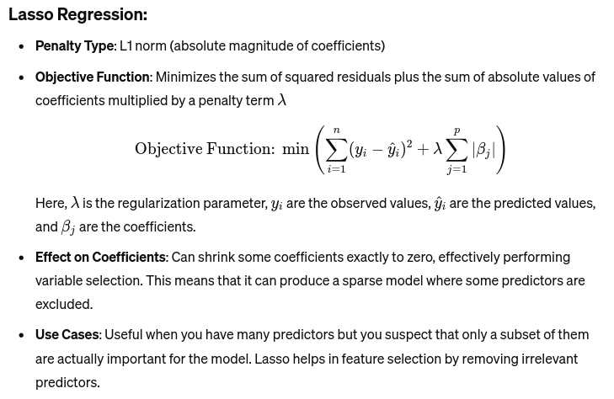

Slide 16
Type of Regularization:
Ridge: L2 regularization (squared magnitude of coefficients)
Lasso: L1 regularization (absolute magnitude of coefficients)
Effect on Coefficients:
Ridge: Tends to shrink coefficients uniformly, but none are set exactly to zero.
Lasso: Can shrink some coefficients to exactly zero, leading to a sparse model.
Use Cases:
Ridge: Better when you want to retain all predictors and control their magnitude.
Lasso: Better when you want to perform feature selection and eliminate some predictors.
Computational Complexity:
Ridge: Generally simpler to compute because the penalty term is differentiable everywhere.
Lasso: Can be more computationally intensive because the penalty term is not differentiable at zero, requiring more sophisticated optimization techniques.

